Slide 1
Case 21: Characters: Mika & Adam
EDUC 336 Jenny Simpson & Rae-Lee Tresierra

Slide 2
Question 1: Facts & key elements of this case
Mika Profile/ thoughts/ attempts to help Adam/ Teaching Adaptations
Adam Profile/ Social Emotional Profile/ Peer Tutoring experience
Other’s opinions: Resource Teacher, Other Teacher’s
FPPL #2 Embedded Throughout This Case Study: Learning is holistic, reflexive, reflective, experiential, and relational (focused on connectedness, on reciprocal relationships, and a sense of place).

Slide 3
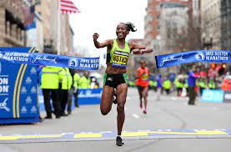
Question 2 Part A: What do we know about Mika Matsuda?
33 years old
Loves poetry & writing
Marathon Runner
SY History Teacher at a Suburban School
Teaching Practice: Asks students about their hockey games or lives outside of school and students will ask Mika about marathons and poetry group
Mika always talks with students individually as they enter the classroom
“Serves as a reward to those who arrive early and allow me to know my students and gain their respect”

Slide 4
Question 2 part b: Adam Profile
Gr. 11
Reads science fiction books
Hard to understand when he is speaking
Person with severe learning disabilities + ADHD
Psycho Educational Report says: Strengths are short term memory and mathematical reasoning
Challenges are: Difficulties with oral communication, sentences are characterized through filler words like “um” makes it challenging for any listener to know what he is talking about- ever
Difficulties focusing attention
Has been on and off medication (Ritalin) for about 8 years
Adam and his parents have decided he will no longer receive medication
“[Adam] is a reluctant writer, whos’ work contains spelling errors. Adam does not shine in social or sports activities. He reads novels always science fiction, describes plot in great detail. Adam will not read the history text”
Written work is: short, conceptionally inadequate and ill-edible

Slide 5
Adam social/emotional profile:
Boasts about being different, but believes it’s easy for people to dislike him because he’s different
Is bullied for unkept nature: Dirty clothes, dirty nails, dirty hair etc…
Frequently expresses his desire of being an individual
Passionate Interest: Computer Games & Internet
Cannot engage with other’s interests (Such as Stu and his favourite computer games that are different than Adam’s)
“School is boring, and I’m alienated from everyone. I get bored here and don’t relate to any of the people”
Does not take responsibility for his lack of social behavior
Blames lack of social connection with peers on external factors such as them being inconsiderate or rude etc…

Slide 6
What is ADHD/ ADD?
“Doctors typically diagnose Attention Deficit Disorder and its close cousin Attention-Deficit/ Hyperactivity Disorder when children are around the age of seven.”
“There are several studies that indicate that ADD and ADHD are inherited conditions, versus attributed to environmental factors.” (Deby. 2021)
SOME SYMPTOMS INCLUDE:
Inattention: Lack of Focus, Difficulty organizing tasks or activities
Hyperactivity: Always in motion, risky behavior
Impulsivity: Blurting out thoughts, lack of control/ understanding of consequences
Impatience with Others: Highs tend to be higher than ordinary, and their lows leave them more upset than many situations would warrant (Deby. 2021)

Slide 7
Mika attempts to help Adam & what she noticed
Asked Adam to stay after school to understand him more and inquire about his plans for his History project
First after school chat: noticed Adam starts each sentence over at least 3x before continuing
Adam always has a point when he starts speaking
Ideas Adam does communicate are always the most interesting

Slide 8
Mika’s attempts to include Adam in class
Mika would Translate Adam’s ideas for the class
Adam’s “bizarre” sentences began making sense to Mika
Students began asking Adam questions, which meant more interpretation

Slide 9
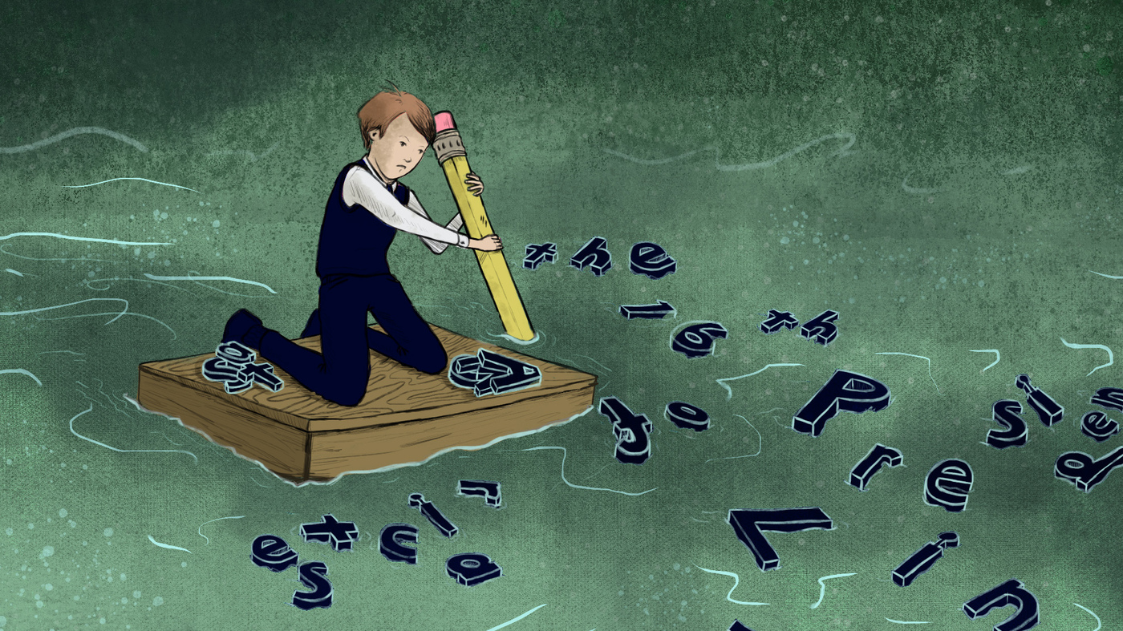
Mika’s concerns for Adam
“I asked Adam what he was learning in his other classes… he responded ‘nothing.’” Instead, he reads his fantasy books during other class
Adam’s other teachers worried about the fact Adam only participated in History
During class conversations, Adam has vocalized his fantasies, made faces, gnawed on his sleeve and starred straight as if he were in a trance

Slide 10
Peer tutoring system for other classes
Bert: Resource Teacher
Described the peer tutoring system he had arranged in the resource room where Students receive peer tutoring credit to help Adam one-on one and argued that was his only way of learning
Mika offered Bert to come observe in her History class

Slide 11
Adaptations
Mika agreed to have a peer tutor help Adam edit his history assignments
Administered tests orally and encouraged other teachers of Adam to do the same
Other teachers claim they couldn’t understand him well enough to figure out his responses

Slide 12
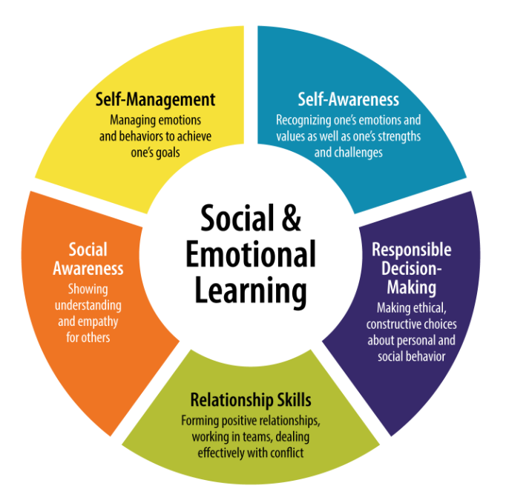
Social/ Emotional & Academics
Adam will receive some credits this semester thanks to the help of the peer tutors
Mika wants to pair Adam with Stu, a kind, competent student who could potentially help Adam socially, and maybe become a friend
Colleagues think Mika would be doing Stu a disservice pairing him with Adam, as the other kids will avoid him or dissociate from him “if he befriends someone as strange and unpopular as Adam.”
Occasionally, Adam will talk with Stu, but does not have the skills to carry a conversation, Stu will get bored and walk away

Slide 13
Question 4 Major Dilemmas:
How Can Adam Learn Social Skills, If No one ever socializes with him, except students who help him in order to earn a credit?
What Could I do as a teacher?
***Refer to Chapter 5, pg. 116 of Hutchinson Text: Communication Exceptionalities***

Slide 14
Q4 Continued: Major dilemmas Adam Social/ Emotional Issue
Strength: comfortable with adults
Growth Area: Adam needs to learn to associate & communicate with peers. Learn to be a friend and how to have a friend.
After Mika hears how much the other teachers strongly disagree with her ideas… she is unsure what to do
“School is just as much about visiting friends as it is academically, but Adam is always alone” - Mika

Slide 15
Question 4 (Q5 prep story): Major dilemmas- Mika
Felt isolated being the only advocate for Adams’ social & academic success
Teachers want to focus on Academics before Social situations
Mika argues that Social should come before academics or at the same time because so much of academics is communicating & collaborating
Adam is in Gr. 11, we are running out of time
Marathon friends have banned all discussions about my students or school- they have said “they are not a therapy group”

Slide 16
Question 5 Prep story: Class Assignment: Practice interviewing an Elder
Teacher assigned herself as Adam’s Interview partner, confident he would be cooperative
“What high school memories could you carry with you?” None. “What friends do you have?” I float. “Who is your closest friend?” He moved away.
“Describe yourself” I’m more of a freak than anyone else. People are afraid of me because I act different and go by my own rules.”

Slide 17
Question 5:What actions could Mika have taken to solve some of the dilemmas in this case? What roles should the resource teacher have taken in resolving these dilemmas
* Mika could have been an interpreter for Adam when doing partnered assignments. Randomized partners for inclusivity. Scribed.
Mika could have Adam do his own speaking and put what he is saying in writing
Could have asked Adam when he prefers and does not prefer having an interpreter
Front loading: give class questions to Adam prior to class so he can have a response prepared and rehearsed
Bert: Be supportive. Learn more about Adam. Find ways to facilitate his learning to be inclusive rather than Adam just receiving tutoring. Bert should know that school is just as much social/emotional learning as it is academic ***Refer to Chapter 5, page 122 of Hutchinson text: Communication Exceptionalities***

Slide 18
Question 6: consider the consequences for Adam’s social life, academic life, and future. Consider the consequences for Bert and for Mika
Social Life: Continue to be the same as long as Mika and Adam are not provided the services they request, and as long as Mika continues to enable Adam to not talk to other students (by offering to be his partner/ speak for him etc…)
Academic/ Future Life: Suffer due to lack of core competencies such as collaboration (group projects), communication, self-awareness etc… will make it hard to build competences for future careers after high school
Bert & Mika: Not learning and developing their pedagogies and teaching practices for future students like Adam

Slide 19
To help a student like Adam, it takes a team! Here are Characteristics of Effective Teams:
Shared Goals
Communication
Trust
Support
Manage Differences
Manage Time
Team Leadership

Slide 20
SY School Students with ADD & ADHD: How Can We Identify Them?
Distractibility
Disorganization
Day dreaming
Poor motivation
Impulsivity
Overactivity
Remember: It is not our role as teachers to make formal identifications, but it is our role to recognize and adapt/ make adjustments to our teachings (like maybe recognizing Adam’s Expressive Language)

Slide 21
Some key Questions for teachers to ask about medication
What is the medication? What information can I read about it?
Why is this medication prescribed for this adolescent? What change should we expect to see at school?
What behavioural program or behavioural therapy is being implemented in conjunction with this drug therapy?
How long will this medication be prescribed for this adolescent?
What are the side effects in the short-term/ long term?
What is the dosage? What is the schedule on which the medication will be taken?
How often are re-evaluations?
Are there foods/beverages or other substances that should not be consumed when one is taking this medication?
What kind of communication is necessary among home, school, and the adolescent to evaluate whether the medication is having the desired effect?
What procedures should be followed if the adolescent accidentally ingests an overdose?

Slide 22
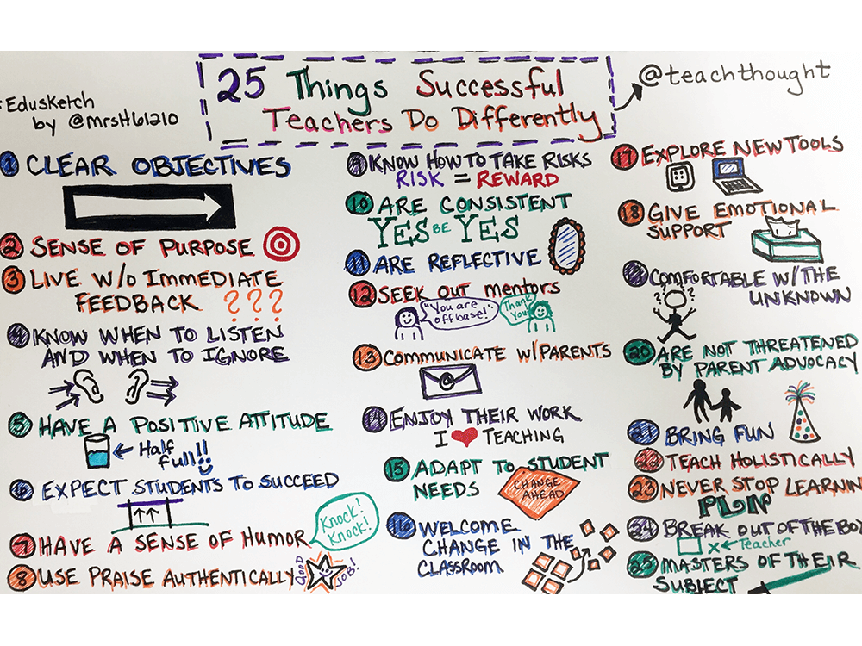
What you can do as a teacher to help ADD/ ADHD Student’s
Be Organized
Plan Ahead
Communicate Expectations Clearly
Structure Lessons
Be Enthusiastic & Engaging
Be Flexible- alternate assignments, various forms of communication
Continue to Learn about such exceptionalities
Be Respectful & Sensitive
Maintain a Sense of Humour

Slide 23
* Our first instinct to help may not always be the best * doing something is better than nothing * Establish healthy critical friends/ colleagues * Learn to advocate for yourself and your students- who to approach * attend professional development relevant to you & your students * SBT (school based team) meetings will teach you a lot (pg. 39 of Hutchinson) What do you think??
Question #7: What Can We Learn from this Case?

Slide 24
* That all educators want to help * That your resource teacher will have all the answers * that sbt (School Based Team) will be effective what do you think?
Question 8: What Assumptions & Beliefs are called into Question by this Case?

Slide 25
References
Deby. (2021, March 3). 10 symptoms of attention deficit disorder - Facty Health. Facty. https://facty.com/conditions/adhd/10-symptoms-of-attention-deficit-disorder/8/.
Hutchinson, N. L. (2004). Case 21: What a Puzzle! In Teaching exceptional children and adolescents: A CANADIAN CASEBOOK. essay, Prentice Hall.
Hutchinson, N. L., & Specht, J. (2020). Inclusion of learners With Exceptionalities in Canadian schools: A practical handbook for teachers. Pearson Canada. L.
Hutchinson, N.L., Freeman, J. G., & Berg, D. H. (2004). Social competence of adolescents with learning disabilities. Learning About Learning Disabilities, 415–448. https://doi.org/10.1016/b978-012762533-1/50015-9
Maki, P. (2010). Assessing for learning building a sustainable commitment across the institution. Stylus.
Stegemann, K. C., & AuCoin Angèla. (2018). Inclusive education: Stories of success and hope in a Canadian context. Pearson Canada.

